Slide 1
Presentation 02
“Modeling Infrastructure and Agents”
Sep 20, 2022

Slide 2
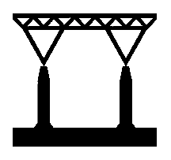
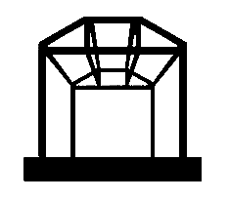
1. Structure: “definition”
May have initial cost of built
Probability of working decreases over time
Based on probability of working at each step, it may stop working
It can be renovated

Slide 3
1. Structure: “unified approach?”
We have different ways of talking about degradation…
In case of buildings, we may deal with overall safety factor as function of time
In case of humans, we may deal with lifetables and distributions
The thorny question is:
“Is there a unified way of describing degradation for both humans and buildings?”
If I don’t reach any conclusion…

Slide 4
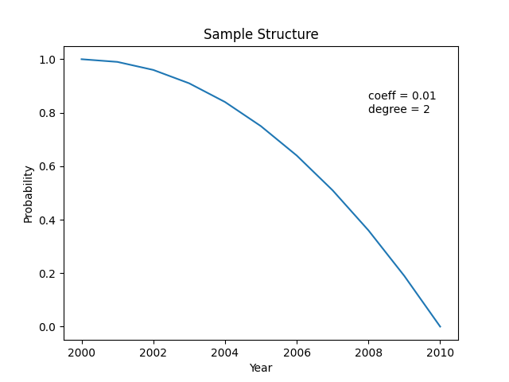
1. Structure: example 1
Probability = 1 - (coeff * (dt_years ** degree))

Slide 5
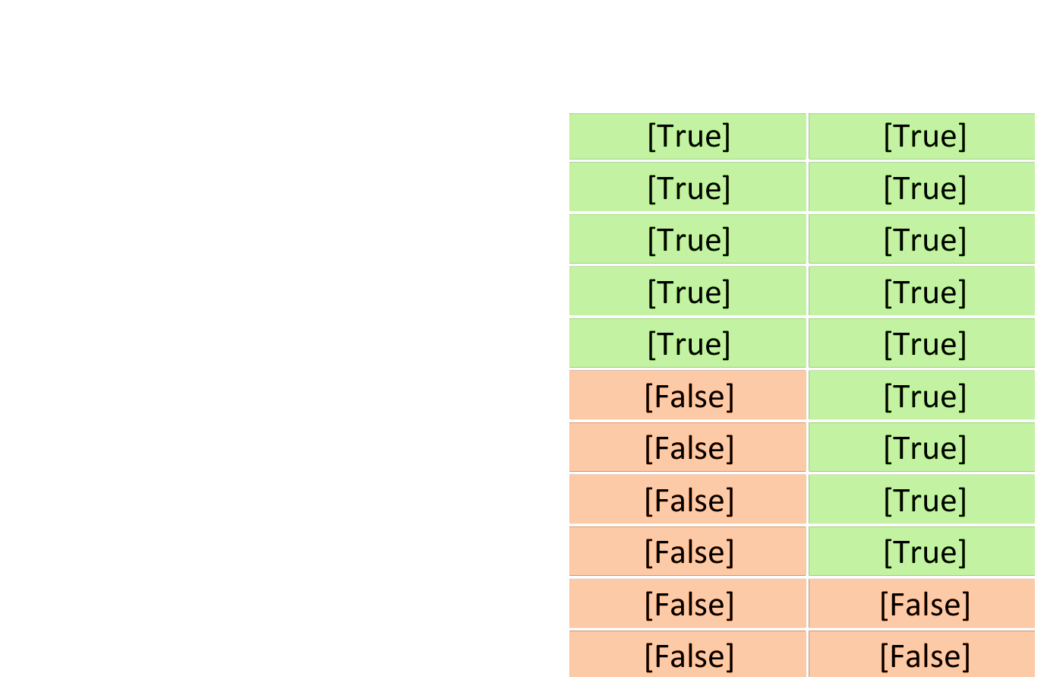
1. Structure: example 1

Slide 6
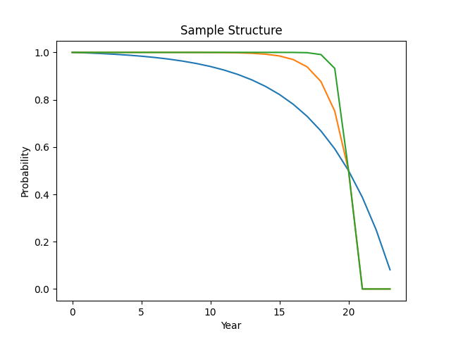

1. Structure: example 2
$$k=0.7$$
$$k=2$$
$$k=0.2$$
$$P_{s}$$
$$t_{s}$$
$P=1+\frac{P_{s}−1}{1−e^{k(t_{s}−t_{0})}}$($1−e^{k(t_{s}−t)}$)

Slide 7
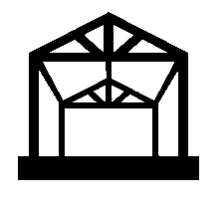
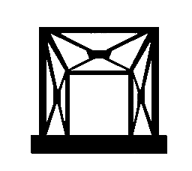
2. Infrastructure
Is a type of Structure (degrades over time)
They have start and end points, and connect settlements (e.g. cities)
They are in charge of handling certain recourses
Definition of other equipment is needed for certain types of infrastructure to be able to transfer resources (e.g. vehicle for roads)

Slide 8
3. Equipment
Is a type of Structure (degrades over time)
May need human operators to work
They are in charge of transferring certain recourses on certain infrastructures (e.g. a truck on road)
They use certain resources to operate

Slide 9
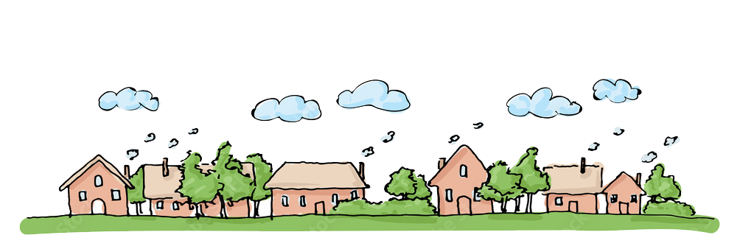
4. Settlement
Is the place that can contain agents (e.g. cities)
Has a radius, and agents within that radius are inside the city
Agents within the settlement, can interact with each other freely
They are the start and end points of infrastructures (e.g. pipelines, roads, etc.)

Slide 10
5. Agents
Is a type of Structure (degrades over time)
They produce/use/store certain resources
They make decisions to optimize their goals (economy is emergent)
They may choose to move to a destination (by vehicle, on foot, etc.)
If deficiency for a resources reaches the threshold, agent dies.

Slide 11
5. Agents: a deeper look inside
The agents contain 4 nodes for each resource:
1. Produce
2. Use
3. Deficiency
4. Storage
Storage
Use
Deficiency
Produce
Agent 1

Slide 12

5. Agents: graph representation
Storage
Use
Storage
Use
Deficiency
Produce
Deficiency
Produce
Agent 1
Agent 2
$$number of edges=5n^{2}$$

Slide 13
5. Agents: edges
Storage
Use
Deficiency
Produce
In the graph, each edge represents a possible transaction.
The starting node has a source, and the ending node will have a demand
The goal of the agents is to find the best ones and accomplish them.
source
demand
starting node
ending node

Slide 14
5. Agents: “produce” and “use”
Storage
Use
Deficiency
Produce
For each resource, an agent:
1. Produce: production rate. At each step, extra production will be wasted
2. Use: use rate. If this need is not met, it will be accumulated as deficiency_current. If this value exceeds deficiency_max, the agent dies.

Slide 15
5. Agents: “deficiency”
Storage
Use
Deficiency
Produce
For each resource, an agent has:
3. Deficiency: at each step, if “use” is not satisfied, accumulates as deficiency. If it reaches “deficiency_max”, agent dies.
properties:
- deficiency_current
- deficiency_max
If it reaches “deficiency_max”, the agent dies.
Only acts as an ending point, with demand value of “deficiency_current”

Slide 16
5. Agents: “storage”
Storage
Use
Deficiency
Produce
For each resource, an agent has:
4. Storage: storage unit
properties:
- storage_current
- storage_max
Acts both as a starting point and ending point, with values of:
(when is end point) demand = storage_max - storage_current
(when is start point) source = storage_current

Slide 17
6. Implementation: “class hierarchies”
class Structure()
class Entity()
class Infrastructure(Structure)
class Equipment(Structure)
class Agent(Entity, Structure)
class Road(Infrastructure)
class Truck(Structure)
class Farmer(Agent)
class Airport(Infrastructure)
class Airplane(Structure)
class Merchant(Agent)
...
...
...
class Model()

Slide 18
6. Implementation: subproblem
An environment with agents only. (no settlement, no equipment, no infrastructure)
Everyone is in contact with everyone else
Resources are transferred instantaneously
There is only one type of resource
The best transaction is found based on score: distance / demand

Slide 19
6. Implementation: subproblem
>>> step: 1
# transaction from "farmer_1___produce" to "farmer_1___deficiency": 5
# transaction from "farmer_1___produce" to "farmer_1___storage": 5
# transaction from "farmer_2___produce" to "farmer_2___storage": 10
# transaction from "farmer_2___storage" to "farmer_2___use": 5
# transaction from "farmer_2___storage" to "farmer_1___use": 5
>>> step: 2
# transaction from "farmer_1___produce" to "farmer_1___deficiency": 3
# transaction from "farmer_1___produce" to "farmer_1___storage": 7
# transaction from "farmer_1___storage" to "farmer_1___use": 5
# transaction from "farmer_2___produce" to "farmer_2___storage": 10
# transaction from "farmer_2___storage" to "farmer_2___use": 5
# transaction from "farmer_2___storage" to "farmer_1___use": 3
# transaction from "farmer_2___storage" to "homeless_1___deficiency": 1
# transaction from "farmer_2___storage" to "homeless_1___use": 1
>>> step: 3
# transaction from "farmer_1___produce" to "farmer_1___storage": 10
# transaction from "farmer_1___storage" to "farmer_1___use": 7
# transaction from "farmer_2___produce" to "farmer_2___storage": 10
# transaction from "farmer_2___storage" to "farmer_2___use": 5
# transaction from "farmer_2___storage" to "homeless_1___use": 1
# transaction from "farmer_2___storage" to "farmer_1___use": 1

Slide 20
7. Steps to take: “introducing trade offs”
There may exist shared storages
Meaning of market needs to be defined at some point
Sample Exchange Rate
I may implement it using exchange rate table
 | food | water | energy
food | 1 | 0.5 | 0.4
water | 2 | 1 | 1.5
energy | 2.5 | 0.75 | 1
Exchange rates:
- Volume
- Value

Slide 21
Thank you for your patience

